Slide 1



Conservation decisions with
exact algorithm solvers
Jeffrey Hanson
jeffrey.hanson@uqconnect.edu.au
jeffrey-hanson.com

Slide 2
Now
Biodiversity
Status quo
2000
Future

Slide 3
Now
How do we
get here?
Biodiversity
Status quo
2000
Future

Slide 4



How do we bend the curve?
Ecological surveys
Distribution maps
Priority areas
Biodiversity
2000
Future
Data
Information
Plan
Outcome

Slide 5
How do we bend the curve?
Ecological surveys
Distribution maps
Priority areas
Biodiversity
2000
Future
Data
Information
Plan
Outcome
Prioritization

Slide 6
Framing conservation as a decision science problem
Goal: what is our vision for the future?
Objective: what quantity are we maximizing/minimizing to help achieve the goal?
Constraints: what things must our solution do to help achieve the goal?
Decisions: what actions could we do to maximize/minimize the objective?

Slide 7





Heuristic
algorithm
Meta-heuristic
algorithms
Exact
algorithms
Estimate of best quality
Quality
Different
solutions
Different
solutions
Different
solutions
PPP

Slide 8
Exact algorithm solvers
Open source and commercial solvers available (e.g., Gurobi, IBM CPLEX, CBC, HiGHS, SYMPHONY)
Automatically select algorithms for different problems (e.g., presolve, simplex, barrier, branch-and-bound)
Broadly speaking have similar functionality, but have different implementations of the underlying algorithms, and have different performance for different kinds of problems
See here for explanation of branch and bound algorithm: https://www.youtube.com/watch?v=CdfZ4XOpSho

Slide 9
Exact algorithm solvers
Solve multiple problem types:
linear programming (LP) = continuous decision variables
integer programming (IP/ILP) = binary/integer decision variables
mixed integer linear programming (MILP) = continuous + binary/integer decision variables

Slide 10
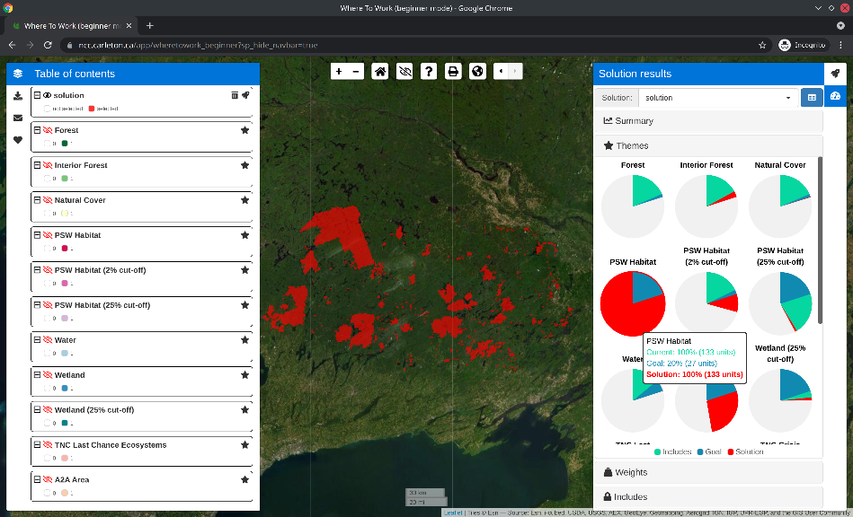
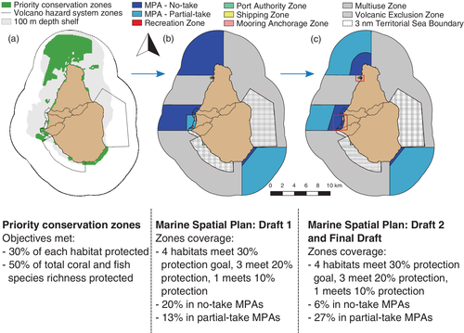
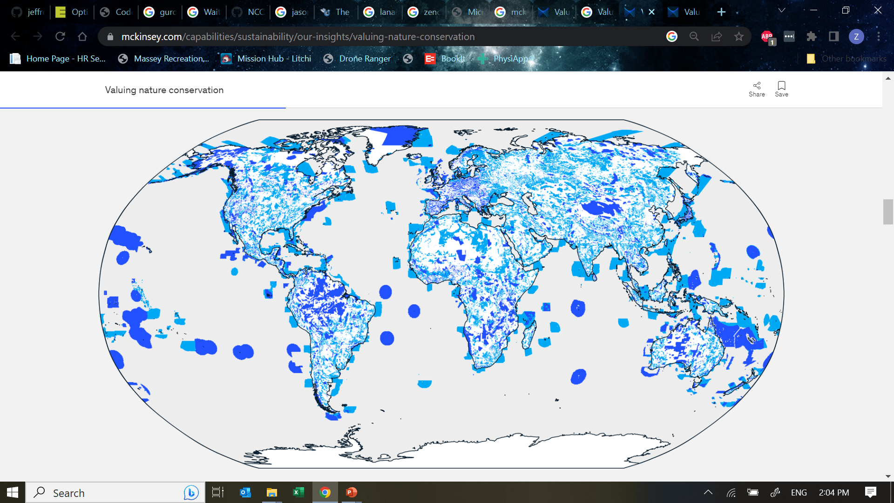
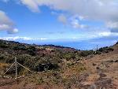
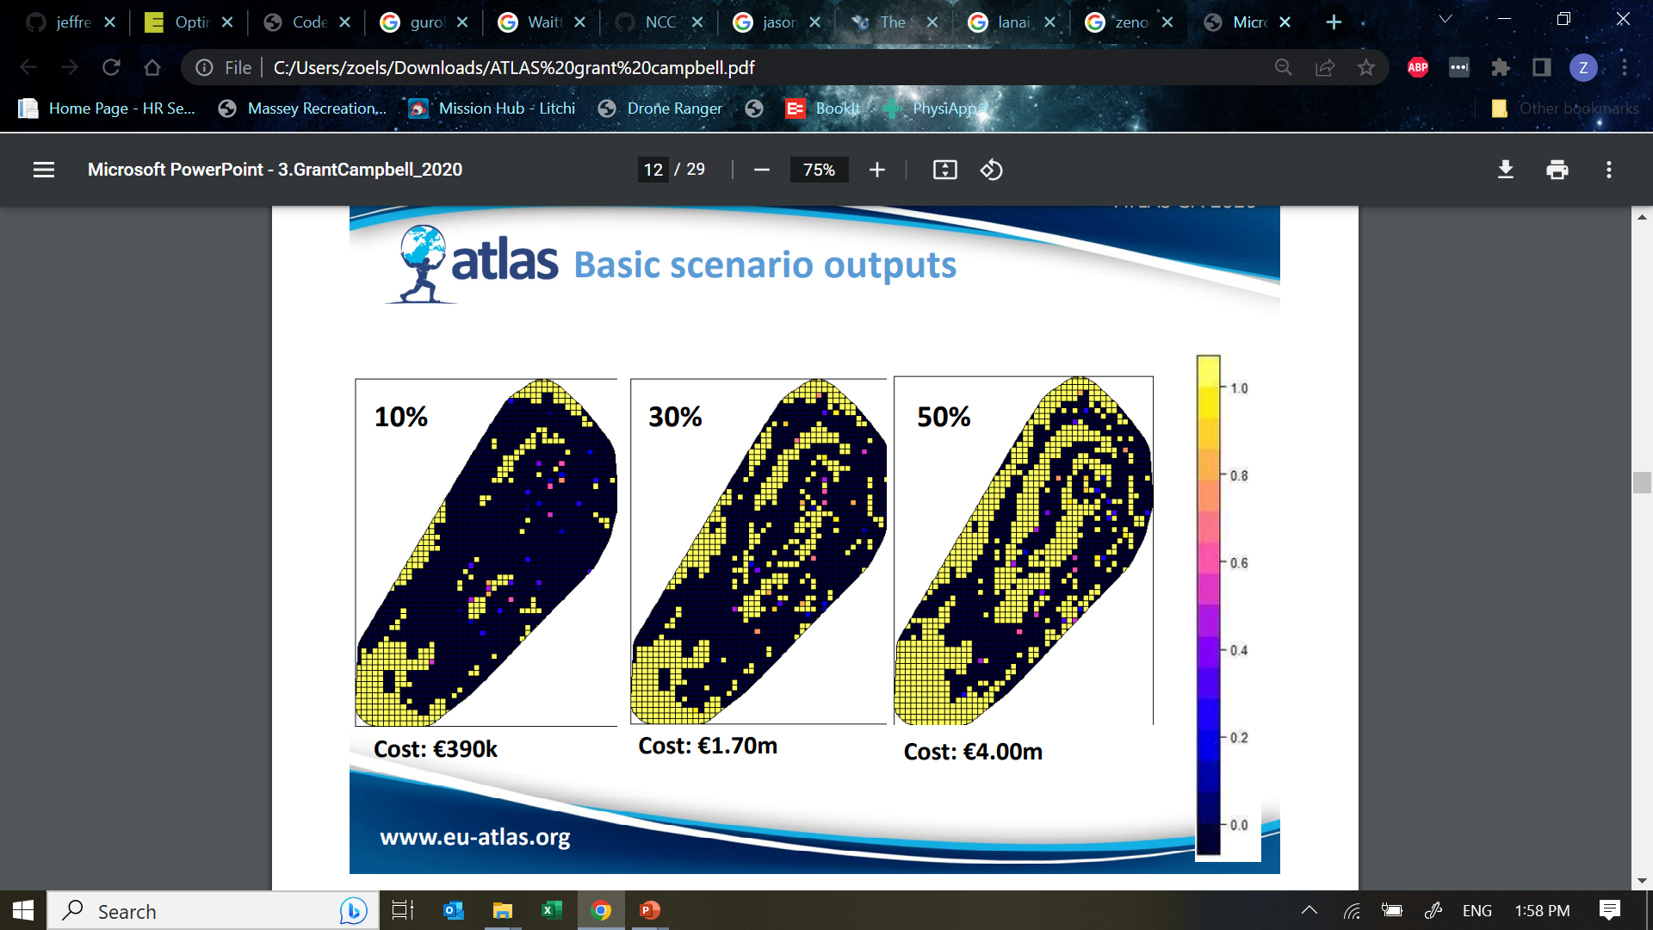
Conservation examples
McKinsey Consulting
Nature Conservancy of Canada for land acquisition
Waitt Institute to help Government of Montserrat
Scottish Government for marine spatial planning in Rockall Bank
USGS to prioritize recovery areas in Hawaii

Slide 11





Reserve selection as optimization
Goal: conserve biodiversity
Objective: min. # of islands
Constraints: sufficient habitat for each species
Decisions: create a reserve on an island or not?

Slide 13
1
2
3
4
5
6
7
8
9

Slide 14
1
2
3
4
5
6
7
8
9
1
2
3
4
5
6
7
8
9

Slide 15
1
2
3
4
5
6
7
8
9

Slide 16
Min €:
+1
+1
+1
+1
+1
+1
+1
+1
+1
1
2
3
4
5
6
7
8
9

Slide 17
2
Min €:
+1
+1
+1
+1
+1
+1
+1
+1
+1
1
2
3
4
5
6
7
8
9

Slide 18
Min €:
+1
+1
+1
+1
+1
+1
+1
+1
+1
1
2
3
4
5
6
7
8
9
+1
+1
1
2
3
4
5
6
7
8
9

Slide 19
Min €:
+1
+1
+1
+1
+1
+1
+1
+1
+1
1
2
3
4
5
6
7
8
9
+1
+1
+1
1
2
3
4
5
6
7
8
9

Slide 20
Min €:
+1
+1
+1
+1
+1
+1
+1
+1
+1
+1
1
2
3
4
5
6
+1
7
8
9
+1
+1
+1
1
2
3
4
5
6
7
8
9

Slide 21
Min €:
+1
+1
+1
+1
+1
+1
+1
+1
+1
+1
+1
+1
+1
+1
+1
+1
+1
+1
+1
+1
+1
1
2
3
4
5
6
7
8
9

Slide 22
Min €:
+1
+1
+1
+1
+1
+1
+1
+1
+1
+1
≥ 1
+1
+1
≥ 1
+1
+1
≥ 1
+1
≥ 1
+1
+1
+1
+1
+1
+1
≥ 1
1
2
3
4
5
6
7
8
9

Slide 23
Min €:
+1
+1
+1
+1
+1
+1
+1
+1
+1
+1
≥ 1
SOLVER
SOFTWARE
+1
+1
≥ 1
+1
+1
≥ 1
+1
≥ 1
+1
+1
+1
+1
+1
+1
≥ 1
1
2
3
4
5
6
7
8
9

Slide 24
Min €:
+1
+1
+1
+1
+1
+1
+1
+1
+1
+1
≥ 1
+1
+1
≥ 1
+1
+1
≥ 1
+1
≥ 1
+1
+1
+1
+1
+1
+1
≥ 1
1
2
3
4
5
6
7
8
9

Slide 25
1
2
3
4
5
6
7
8
9
1
2
3
4
5
6
7
8
9

Slide 26






Exact algorithm solvers
lp_solve

Slide 27

Cost and licensing
Open source
Commercial
lp_solve

Slide 28
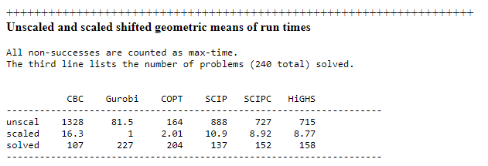
General performance
Modern benchmarks (April 2023)
CBC vs Gurobi vs HiGHS

Slide 29
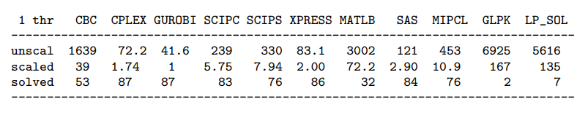
General performance
Historical benchmarks (Oct 2018)
See how CPLEX and lp_solve compare

Slide 30
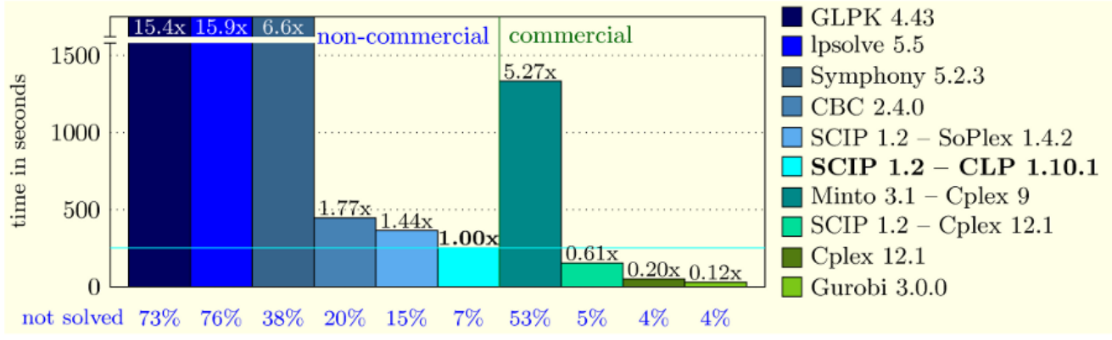
General performance
Historical benchmarks (2010)
See how Symphony compares

Slide 31
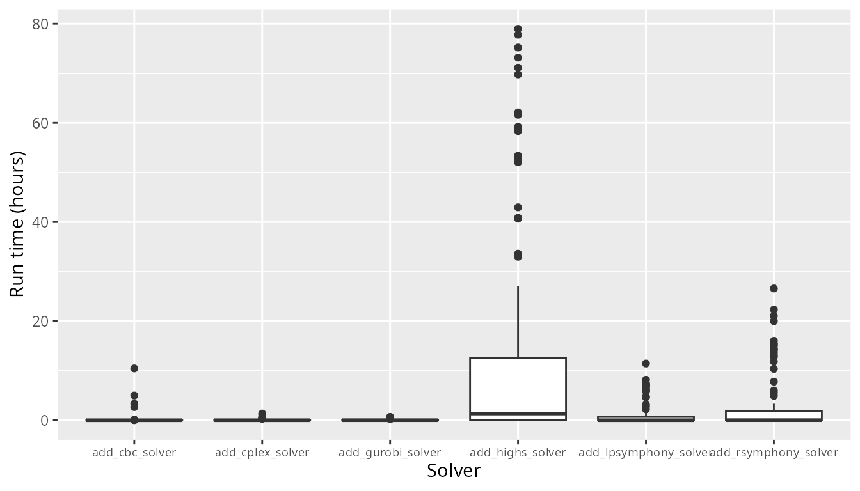
Performance for a conservation problem

Slide 32
Running the software programmatically
Gurobi (gurobi R package)
IBM CPLEX (cplexAPI and Rcplex R packages
Symphony (lpsymphony and Rsymphony R packages)
CBC (rcbc R package)
lp_solve (lpsolveAPI R package)
HiGHS (highs R package)
Software interfaces are available for other programming languages too!

Slide 33
Recommendations
Gurobi is the best solver, and a special academic license is freely available
CBC and HiGHS are the best open source solvers
All three solvers have fairly similar R package interface, so running the same analyses with different solvers is relatively straight forward

Slide 34




jeffrey.hanson@uqconnect.edu.au
github.com/prioritizr/prioritizr
prioritizr.net

Slide 35
Project prioritization
Project data
Recovery projects

Slide 36




Feature data
Phylogenetic data
Stakeholder weights
Project prioritization
Project data
Cost data
Actions
$
$$
$$$
Recovery projects
$0

Slide 37
Project prioritization
Feature data
Phylogenetic data
Stakeholder weights
Project data
Cost data
Actions
$
Success
$$
90%
$$$
20%
Recovery projects
$0
50%
100%

Slide 38
Project prioritization
Feature data
Phylogenetic data
Stakeholder weights
Project data
Cost data
Actions
Persistence (%)
$
Success
$$
90%
95%
$$$$$
20%
10%
Recovery projects
$0
50%
70%
100%
40%
9%
65%

Slide 39
Project prioritization
Feature data
Phylogenetic data
Stakeholder weights
Project data
Cost data
Actions
Persistence (%)
$
Success
$$
90%
95%
$$$
20%
10%
Recovery projects
$0
50%
70%
Budget
$$$
100%
40%
9%
65%

